Slide 1


Dalai Lama
Nobel Prize Acceptance Speech
Diya -838
Anna- 834
Tanu- 863
Gautam-807

Slide 2
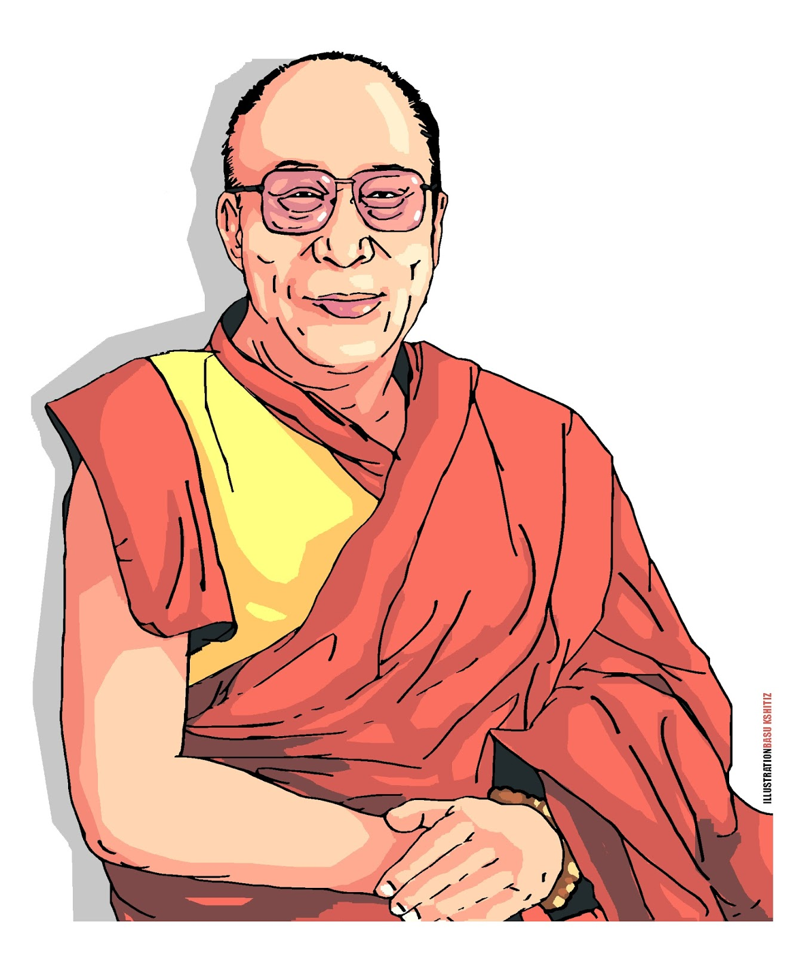
Who is Dalai Lama?
Foremost spiritual leader of the Gelug or "Yellow Hat" school of Tibetan Buddhism.
The 14th and current Dalai Lama is Tenzin Gyatso.
Successor in a line of tulkus who are believed to be incarnations of Avalokiteśvara, a Bodhisattva of Compassion.
The name is a combination of the Mongolic word dalai meaning "ocean" or "big" and the Tibetan word lama meaning "master, guru".

Slide 3

Importance of Dalai Lama
His personage has always been a symbol of unification of the state of Tibet, where he has represented Buddhist values and traditions.
A symbol of Tibetan nationhood for Tibetans both in Tibet and in exile.
The traditional function of the Dalai Lama as an ecumenical figure is holding together disparate religious and regional groups.

Slide 4
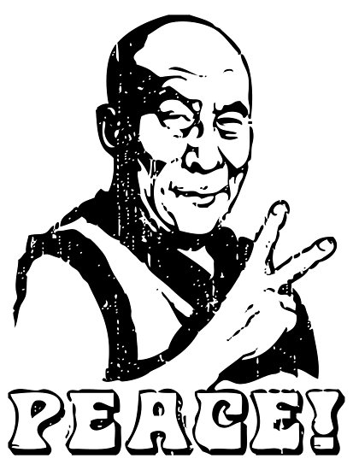
Important events in his life
The people demonstrated nationalism when they discovered China’s plan to capture the Dalai Lama. The Dalai Lama fled to India in exile.
Nobel Peace Prize on December 10, 1989, for his pacifist actions to defend Tibet from Chinese control.
The Dalai Lama stepped down from his political role in Tibet to permit a new generation of political leaders to take over.
March 1959
1989
2011

Slide 5
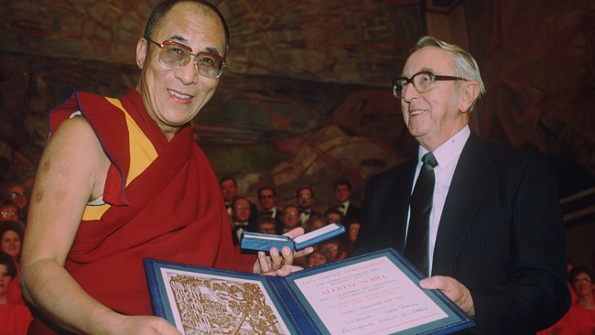
Nobel peace prize
He based his Buddhist peace philosophy on reverence for all living things and the idea of a universal responsibility that embraces both man and nature.
He had showed willingness to compromise and seek reconciliation despite brutal violations.
The Norwegian Nobel Committee said he worked toward peaceful solutions in hopes that Tibetan heritage would be preserved.
The Dalai Lama was selected from 101 nominations, including Nelson Mandela and Ronald Reagan.

Slide 6

HOW IS DALAI LAMA RECOGNISED
•The Dalai Lama is found rather than chosen.
•He is believed to have the power to choose the body into which he is reincarnated, meaning that the current Dalai Lama is a reincarnation of the last.
•The selected boy and his family are taken to Lhasa, where the boy can study the Buddhist sutra to relearn knowledge accumulated in previous lives in preparation for spiritual leadership.

Slide 7
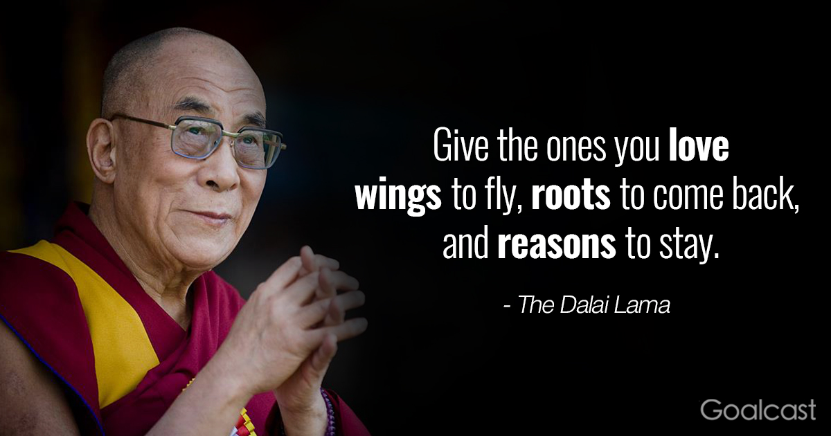
HIS CURRENT PLANS FOR TIBET
Closing the Gap Between Rich and Poor
Democracy and Peace
Human Rights
Improving Observance of Human Rights

Slide 8
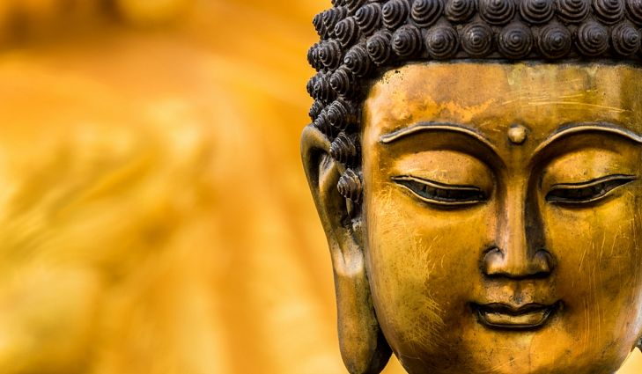
M
Goals of the speech
Dalai Lama’s goal: To motivate
Primary message: Build a better world through love and understanding
Why the Dalai Lama? In recognition of his non violent campaign over nearly 40 years to end China’s domination of his homeland, Tibet.
Objective achieved: Not yet

Slide 9

Setting & Speech Opening
Where and When: Oslo, Norway on December 10,1989.
Opening line was simple with a powerful visual.
Established intent of presentation
The Dalai Lama’s speech was a memorable one, not by how he says it, but by what he says

Slide 10

Analysis of Persuasive techniques
ETHOS: “I believe the prize is a recognition of the true value of altruism, love, compassion, and nonviolence which I try to practice.”
LOGOS: “All of us human beings want freedom and the right to determine our own destiny as individuals and as peopled. That is human nature.”
PATHOS: “I accept the Nobel Prize on behalf of the six million Tibetan people, my brave countrymen and women inside Tibet, who suffered and continue to suffer so much.”

Slide 11
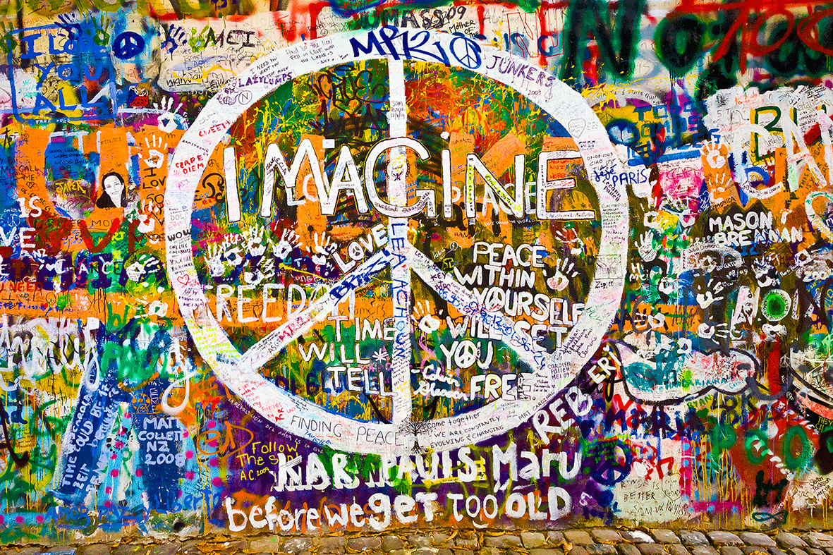
Speech Dissection
Acknowledgement of the atrocities committed by the mankind.
Provokes us to rise above prejudice and affirms that all are ‘humans’.
Everyone seeks freedom, right to determine destiny
Staunch supporter of Mahatma Gandhi
Suffering caused by ignorance
Impact of science
Ancient values deeply engraved within us

Slide 12
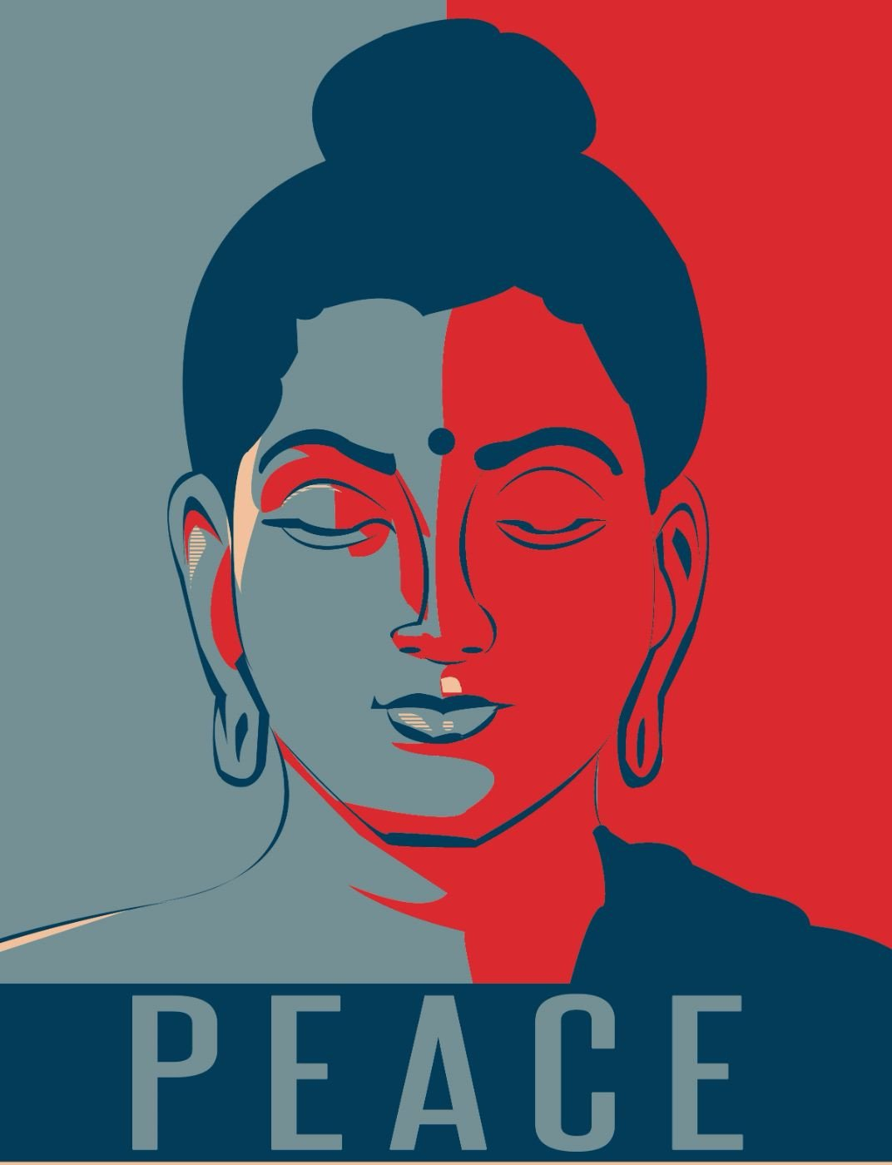
Conclusion was concise and memorable
Speaker was engaged and his message mattered to him
No humour was used
Language was appropriate. No use of jargon, complex language or rhetorical devices.
Speech conclusion

Slide 13
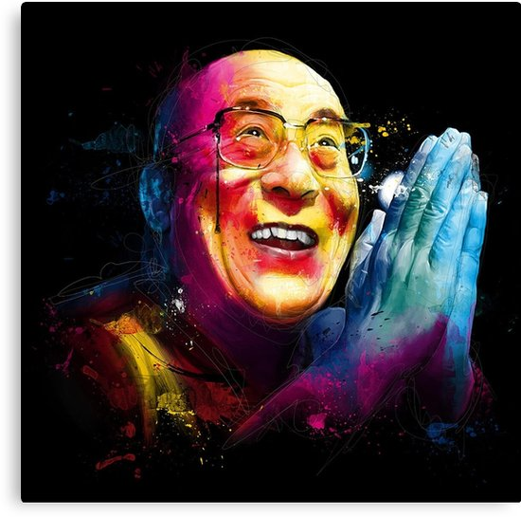
Impact and Conclusion
impact
Provoked a change in the speaker’s audience to build a better world through human understanding and love with lasting effects.
Conclusion: It instils hope and a positive outlook on how to build a better life.

